Slide 1

Megan K. Clarke Chief Information Officer Graduate School of Business Stanford University

Slide 2
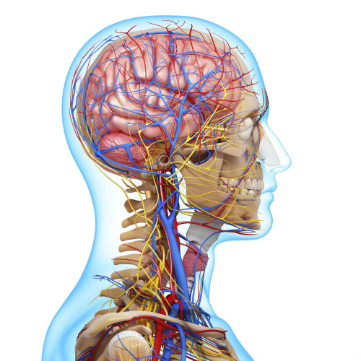








Who Is Megan? My Career Journey
Baan, Siebel, SAP
-Sr. Consultant
-Senior Project Manager
-Senior Program Manager
-Change Management Specialist
Senior Director, IT
Chief of Technology
Managing Director/
CIO
CIO
CIO

Slide 3
Who Is Megan? Outside of the Office
Professional Dancer
Member of Improvisational Comedy Troupe
Choreographed Sword Fighting Fanatic
Teacher of New Decision Making Skills Through Yoga to Prisoners
Guest Speaker for Girls Who Code
Instructor of Your Inner Mean Girl
Instructor of May Cause Magnificence
Dog Rescuer/Foster Mama
Creator of JoyFULL Happenings
Consultant for XXXXXX – help people eat healthily and feed the world

Slide 4


What I Learned On the Way….
Hire People Smarter Than You. Delegate
Develop/Expand Your EQ
(Emotional Intelligence)

Slide 5

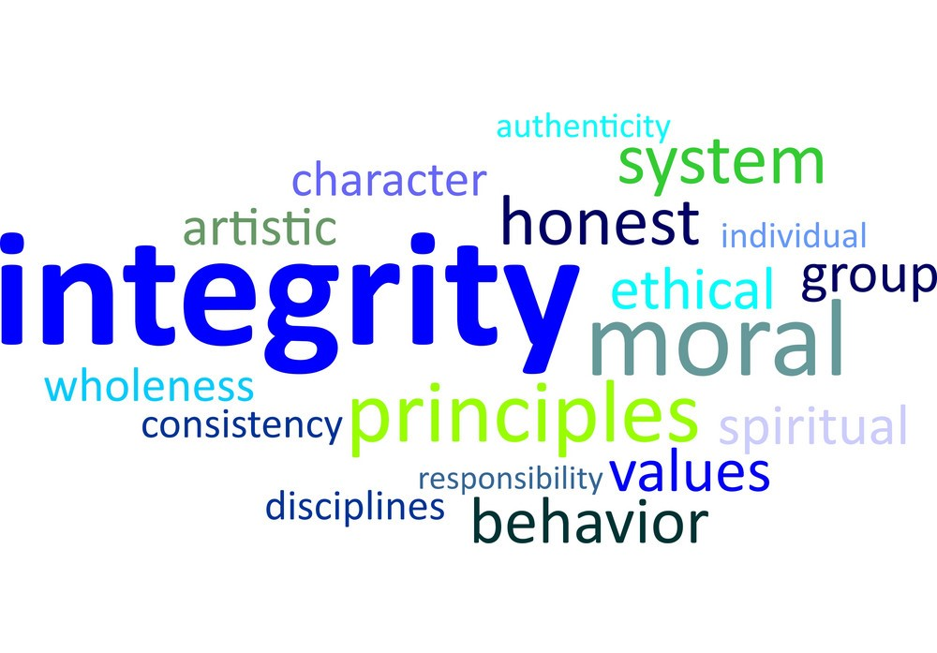
What I Learned On the Way….
Trust Yourself
Work With Integrity

Slide 6


What I Learned On the Way….
Face Your Fear
(Do It Anyway)
Be Authentically You

Slide 7


What I Learned On the Way….
Know Your Worth
Push if Needed

Slide 8


What I Learned On the Way….
Define Happiness for Yourself
Find Your Tribe/Circle/ Group/Support Mechanism

Slide 9
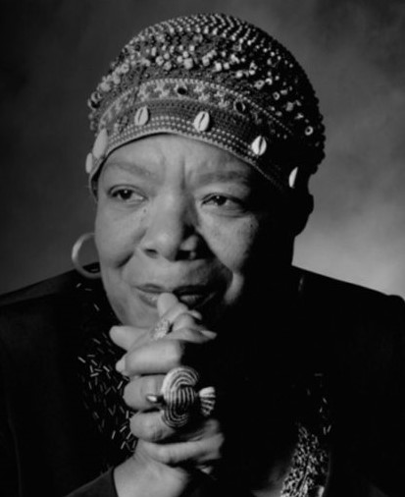
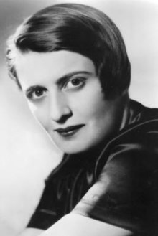
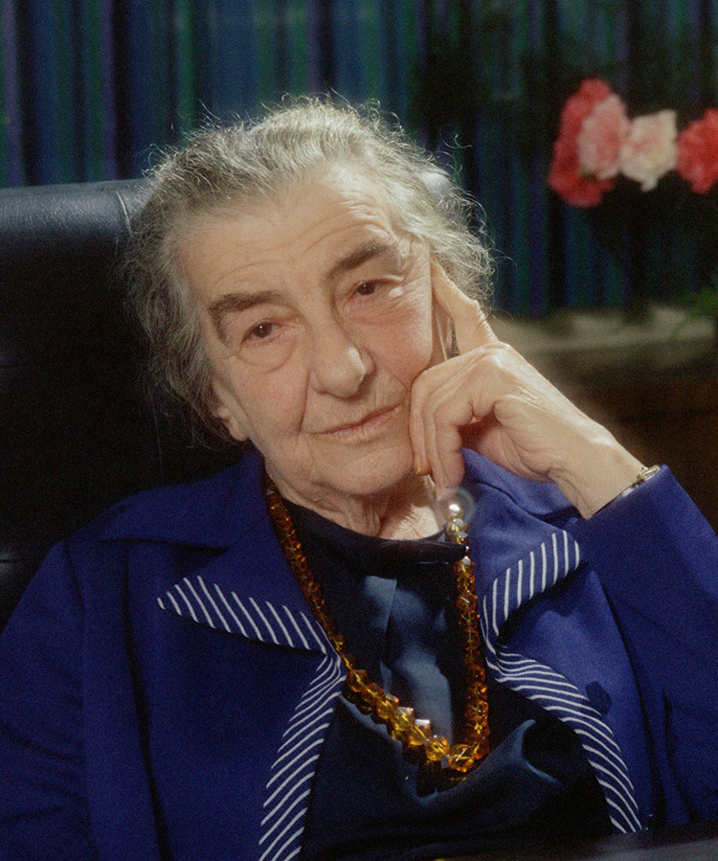
Parting Inspiration
You attract what you are,
not what you want.
If you want great,
then be great.
The question isn’t who’s going to let me, it’s who is going to stop me.
-Ayn Rand
If you’re always
trying to be
normal you will
never know how amazing you can be.
-Maya Angelou
Make the most of yourself by fanning the tiny, inner sparks of possibility into FLAMES of
achievement.
-Golda Meir

Slide 10
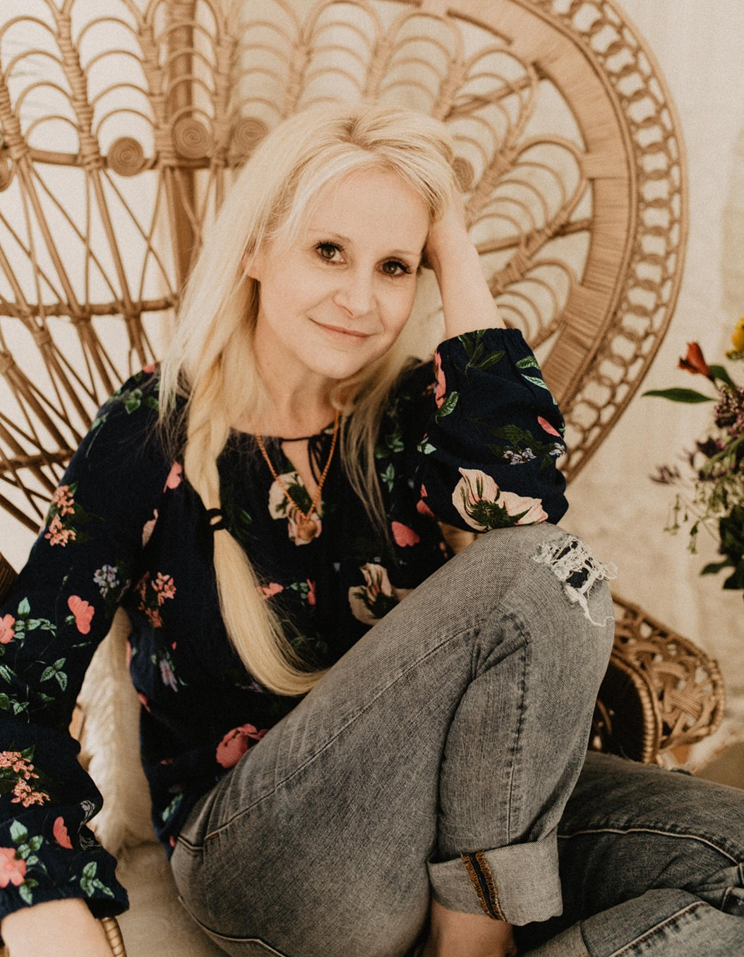
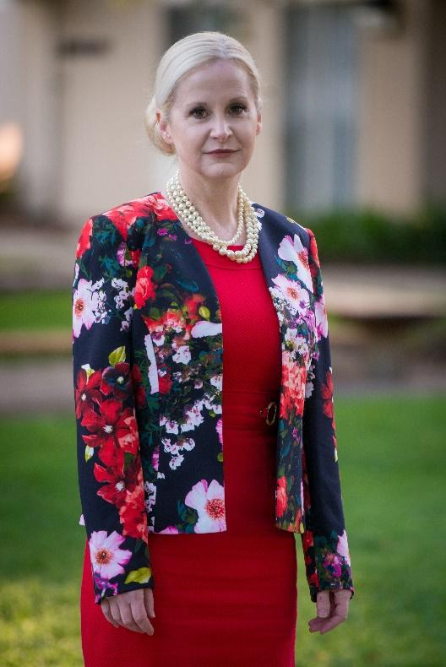
Find/Join/Follow Me
megankclarke@megankclarke.com
Instragram: megan.k.clarke_
Twitter: @megan_k_clarke
Facebook: megan.k.clarke
@soulfulcio

